Slide 1
Dependency Injection
Traineeship

Slide 2
Who am I?
Lode Kennes
3 years @ Axxes
.NET Developer
Projects at SWF, OTN Systems, Syneton
Integration layer between Axxes apps
Self employed (seconday activity)
Ask me anything!

Slide 3
Who are you?
Focus on?
Familiarity with .NET landscape?
Experienced with IOC?

Slide 4
Practical
Just ask questions!
Part 1: 8.30 – 12.00
Part 2: 13.00-17.00
Break in between? Just ask ☺
Demo’s and slides on Bitbucket
Demo’s prepared on
VS 2019
.NET 5.0
.NET 4.8

Slide 5
SOLID
Dependency inversion principle
High level modules should not depend on low level modules
Modules should depend on abstractions

Slide 6
Agenda for today
Dependencies and coupling
DI principles + IOC containers
Service locators
Other techniques for object creation
Architectural styles built around dependencies

Slide 7
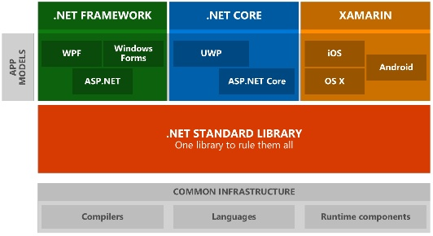
.NET App models

Slide 8
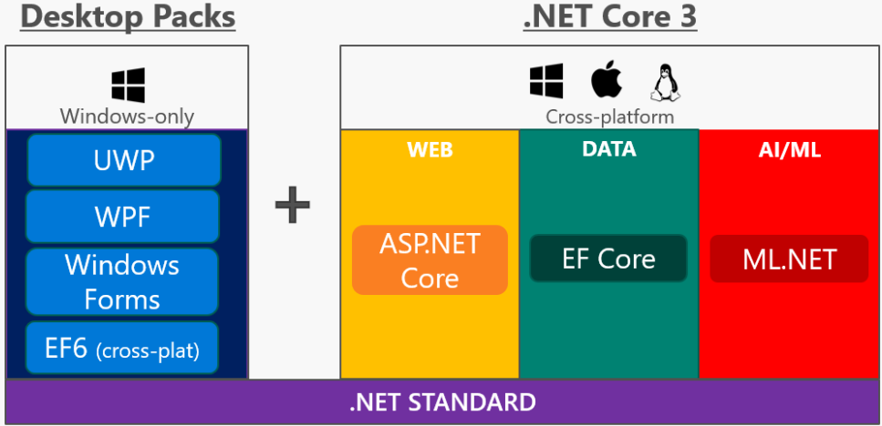
.NET App models

Slide 9

.NET App models

Slide 10
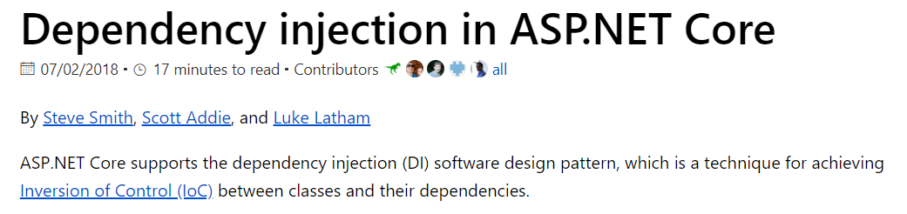
ASP .NET Core

Slide 11
Inversion of control isn’t hard

Slide 12
Why coupling is bad?
What does it mean?
Class / components depending on other classes and components
Limits functionality to a single known implementation
➔ You can’t swap the implementation without breaking the code
Code is not testable
During a unit test you want to test a piece of the component not the whole flow -> Integration
Agile practices are hard to accomplish
Working with multiple team members on the same feature is hard
It’s bad for your reputation as a developer ☺

Slide 13
Embrace abstraction
The secret to writing decoupled/testable software:
Write against abstractions instead of concrete implementations
Stop newing up classes
Note: not talking about models or dto’s
New is glue

Slide 14
Embrace abstraction
Define dependencies as interfaces
Remember the definition of an interface:
A public contract where the consumer talks to the interface and does not know the actual implementation​

Slide 15
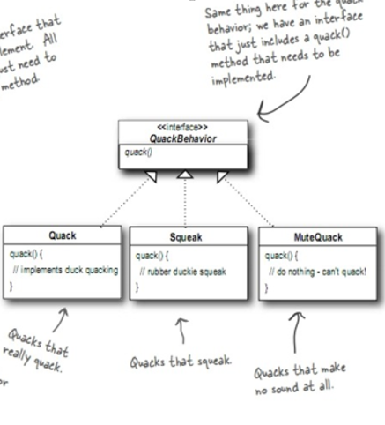
Remember this

Slide 16
Embrace abstraction
This is how most educational programs used to learn students about interfaces
Only from a polymorphic point of view
Making classes implement interfaces is there a cost?
In the old days of OO not every class was an interface​ because working with an interface was slower​

Slide 17
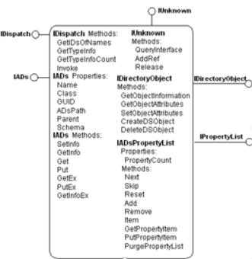
Embrace abstraction

Slide 18
Demo DI.Essentials.Coupled, DI.Essentials.Abstraction, DI.Essentials.UnitTests

Slide 19
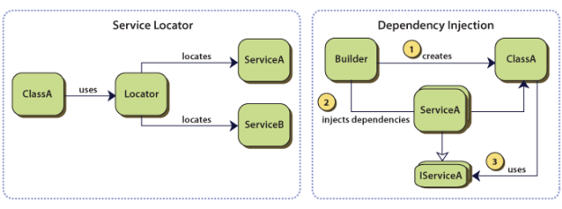
Object creation (IOC)
Invert the creation of objects​
“Creation Inversion”​
Create objects outside of the class they are being used​
Factory pattern​
Service locator​
Dependency injection​
2 flavors: pull or push mechanisms

Slide 20
DI container
A repository for definitions typically relating an abstraction to a concrete class
Think of it as a bucket
Core functionality
Provide facility to register classes related to an interface
Provide facility for resolving a request from a given interface
So it’s about registration and resolving
Push mechanism
​

Slide 21
DI container
Registrations or type associations can be achieved in different ways depending on the container you are using
Procedural (fluent interface)
Unity, Ninject, Castle Windsor, StructureMap, Autofac, Microsoft DI
Configuration
Spring.net, Autofac
Declarative (with attributes)
MEF
Registrations only needs to be done once. Mostly done in some kind of startup file.
​

Slide 22
DI container
Resolving process
Recursively resolving dependencies
Requesting one class from the container starts a chain reaction
Different mechanisms​
Constructor injection​ (most common)
Properties injection​
Interface injection​ (never used this)
Method injection (most frameworks don’t support this)​
​

Slide 23
DI container
Resolving process
Recursively resolving dependencies
Requesting one class from the container starts a chain reaction
Different mechanisms​
Constructor injection​ (most common)
Properties injection​
Interface injection​ (never used this)
Method injection (most frameworks don’t support this)​
​

Slide 24
Demo PoorMansContainer

Slide 25
Ninject
Open source Ioc container ​
First version in 2007​
Simple​
Extensible​
Good community -> a lot of nuget packages​

Slide 26
Castle Windsor
Open source IoC container​
Part of the Castle project​
Set of tools for .NET and Xaml​
One of the first IoC containers for .NET​
Creator also worked on MEF as a program manager at Microsoft

Slide 27
Autofac
Open-source IoC container originally developed on Google Code​
Was the first to also windows phone and windows store apps​
Works with a Builder constructed with lambda’s​. The container is created by the builder.
Gaining a lot of popularity over the last years​
Allows injection via xml configuration -> change wiring without recompiling

Slide 28
Microsoft Dependency Injection
Built-in
Fluent API
Really fast
Default in ASP .NET Core Applications

Slide 29
Demo DI.Containers.*

Slide 30
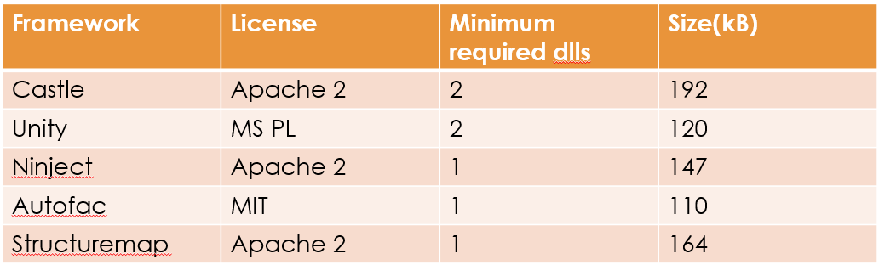
Which container?
Size and licensing?

Slide 31
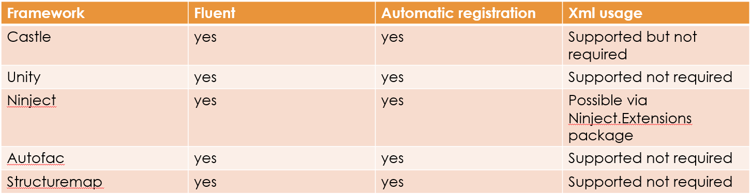
Which container?
Registration/configuration flavor

Slide 32
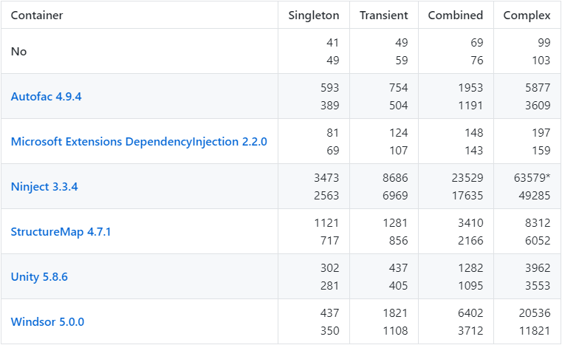
Benchmarks

Slide 33
Which container?
Benchmarks
https://github.com/danielpalme/IocPerformance
Community
Active development
Documentation
Extensions
Reputation of contributors

Slide 34
Instance lifetime
Transient​
Resolved instance kept until parent goes away​
Default in most containers​
Singleton​
Shared instance​
Resolve request returns the same instance until container goes away​
Be careful with threads​
Scoped
Every http request
DbContext of EF you don’t want to share this with other end users

Slide 35
Instance lifetime
How are objects coming from a container disposed?
In a regular program the instance is garbage collected when out of scope
In general the rule is only call Dispose() on object you are the owner
Objects you newed
You can not assume you are the only consumer of the object
IoC containers don’t know when dispose was called on an instance​
When the container is disposed the instances get disposed​
Or you can tell the container when to dispose by defining a scope if it is supported by the container

Slide 36
Instance lifetime
Setting up registrations in big applications is a lot of work
Sometimes you want to work based on conventions
More dynamic
Accomplished via assembly scanning

Slide 37
Modules
When your application grows the bootstrap code for DI also grows
How to organize these registrations?
A module is a small class that can be used to bundle up a set of related components behind a ‘facade’ to simplify configuration and deployment.
Modules do not use dependency injection themselves
Most containers use modules for
Packing similar services together
Optional application futures (Plugin style)
Environment specific registrations
http://autofaccn.readthedocs.io/en/latest/configuration/modules.html

Slide 38
Multiple constructors
What with multiple constructors​?
Different strategies depending on the container
The first constructor they find in code​
The constructor with a metadata attribute​
What I don’t like here is scattering the DI containers code around in your code​
The constructor with the most parameters ​ -> greedy

Slide 39
Post-construction resolve
Kicks off resolve process AFTER the class has been instantiated
Useful when your class is created at a certain moment in time by something else
Remember! Only property injection is possible here, no construction injection

Slide 40


Slide 41
ASP .NET Core
Out of the box support for DI
Custom basic container implementation
It’s possible to plug an existing DI container into the asp net core framework
Asp net core is open source so all code for DI can be seen here
https://github.com/dotnet/extensions
https://docs.microsoft.com/en-us/aspnet/core/fundamentals/dependency-injection

Slide 42
Demo ASP Net Core DI

Slide 43
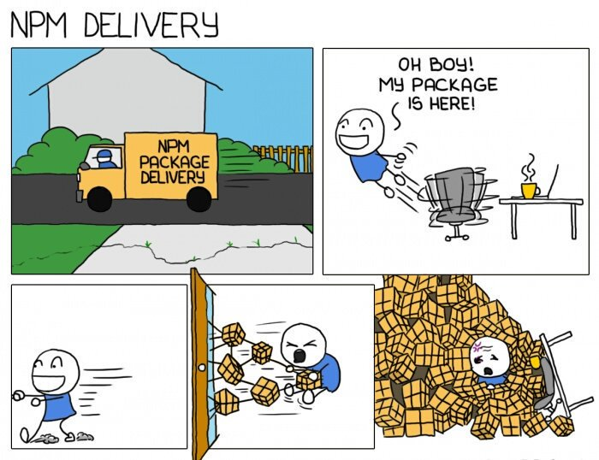

Slide 44
Service locator
Pull mechanism​
Used when a class needs a lot of dependencies (stops constructor parameter explosion)
Can be used instead of post construction resolve
Returns the correct service based on a key​
Wraps a registry which can be a dictionary, an IOC container or something else​
In case DI container is wrapped -> on-demand instances
Biggest disadvantages​
Only one registry -> pay attention with concurrency​
More vulnerable for runtime errors​

Slide 45
Service locator anti-pattern
According to some people service location is an anti-pattern
Originates from Mark Seemann’s book and blogpost
http://blog.ploeh.dk/2010/02/03/ServiceLocatorisanAnti-Pattern/
In short the problem is you may not see the dependencies of a class with a service locator like you see them with a DI container
Causing runtime errors instead of compile time errors
Maintenance hell
In my opinion it depends how you use the locator
https://stackoverflow.com/questions/22795459/is-servicelocator-an-anti-pattern/22795888#22795888

Slide 46
Demo service locator

Slide 47
Factory pattern
Design pattern​
Uses a pull mechanism​
Mostly done with 2 abstractions​
on the factory itself​
on the instance the factory creates​
Advantage client code must not change​
Disadvantage when we need a new concrete implementation the factory code will need to change​

Slide 48
Demo factory pattern
Create FastFoodFactory & OrganicFoodFactory
Make Test work

Slide 49
Conclusion
The core principle of testable code is usage of interfaces to build decoupled components
Containers offer different features
For most part, all accomplish the same thing
Choose the one that you like
Inversion of control != DI container
A DI container does NOT facilitate testing
The DI concepts do
Service locator is an anti-pattern -> it depends

Slide 50
The problem

Slide 51
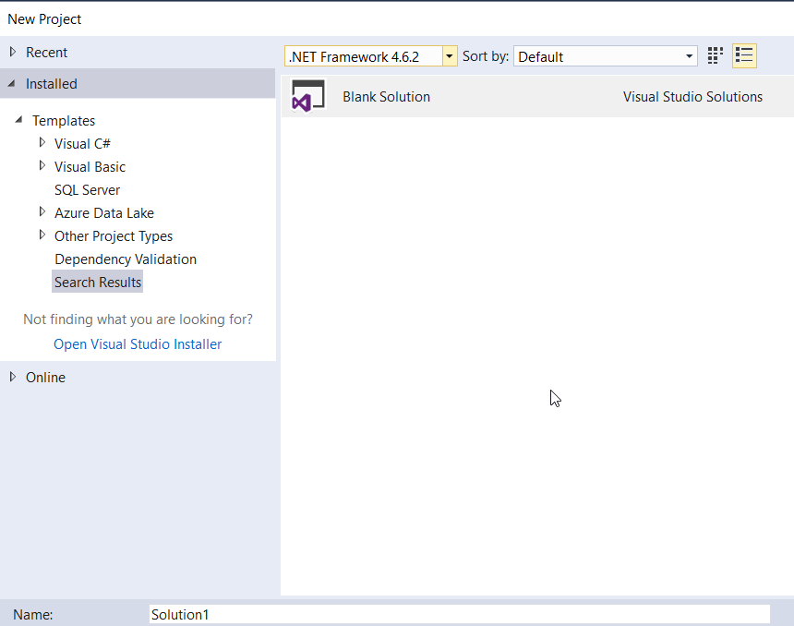

Slide 52
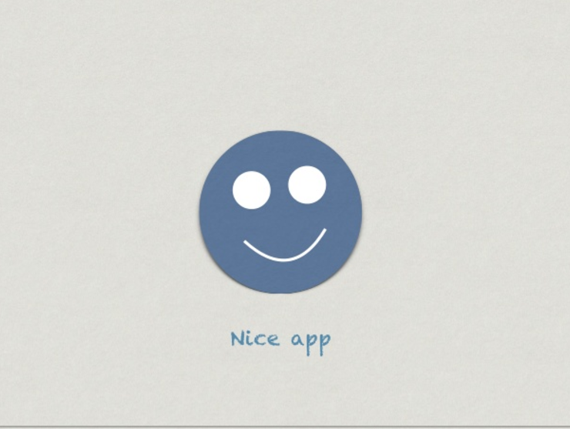

Slide 53
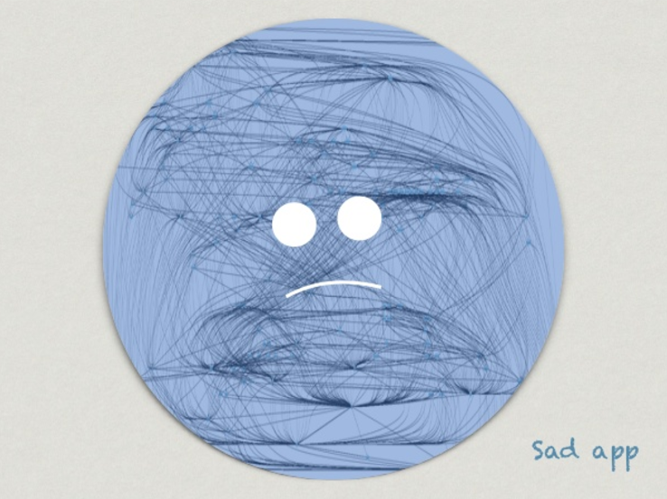

Slide 54
Because
Bad abstractions
Wrong cohesion
Which things belong together
2 much developer freedom
Coupling to frameworks and libraries
Utility projects
Frameworks scattered all over the application
Frameworks only help with encapsulation
No guidance
How do you start a new project?

Slide 55
A good solution
Classes that change together should be packaged together​
Deployment deliverables​
Separation of concerns​
Applies to classes and components​
Establish boundaries to seperate behaviours and responsibilities in a system​
Remember a class should only be responsible for only one thing, the same is true for components​

Slide 56
Companies try to solve this in different ways
A written guide​
Publisher is a developer with lot's of experience​
Several custom project templates​
Still to much responsability for the developers​
Code reviews​
Guidance automation​
Best approach​
Problems to get it to work(installation, errors with recipe)​
Developers can still decide to put logic in the UI

Slide 57
Architectural patterns
Not design patterns​
Help to structure your solution and software​
Keep track of dependencies​
Ways of laying out your software/solution​
Help you to make decisions about coupling and cohesion
How are things linked to each other?
Which things belong together?

Slide 58
3-tier architecture

Slide 59
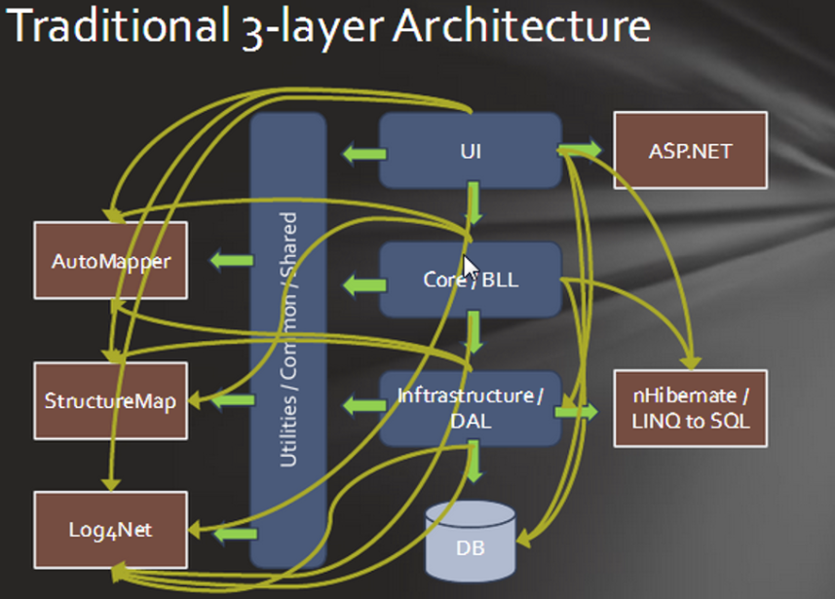
First answer on cohesion and coupling: 3 layered architecture

Slide 60
3 layered architecture
The concept of layers isn’t something new
Think about the OSI model in networking
Every layer is depends on the layer beneath it
Every layer delegates subtasks to the layer underneath it
At least 3 layers but there is no guidance on the number of layers that should be used
In real life, you can usually count the number of layers within an application by knowing the number of tech leads previously involved on the project
Baklava architecture

Slide 61
3 layered architecture
The business layer depends on the data layer
Easy for developers to put logic in UI​
Easy to pass business logic on purpose or accidentally and perform data access in UI
Devs struggle with finding correct place for code​
Product is built on top of a technology which can change over time(asmx → WCF)​
Logic is scattered, hard to locate code​
Library explosions: easy to add references (log4net, automapper, IOC containers)

Slide 62
Onion architecture

Slide 63
Onion architecture
First defined in four blogposts by Jeffrey Palermo​
http://jeffreypalermo.com/blog/the-onion-architecture-part-1/
http://jeffreypalermo.com/blog/the-onion-architecture-part-2/
http://jeffreypalermo.com/blog/the-onion-architecture-part-3/
http://jeffreypalermo.com/blog/onion-architecture-part-4-after-four-years/
Very similar to hexagonal architecture
Architectural pattern where the core object model is represented in a way that does not accept dependencies on less stable code
Switch the direction of dependencies

Slide 64
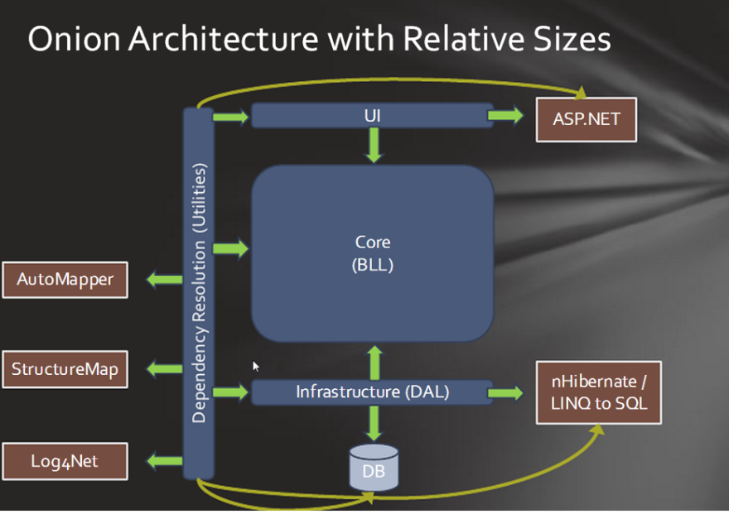

Slide 65
Onion architecture
The application is built around an independent object model​
Inner layers define interfaces. Outer layers implement interfaces​
Direction of coupling is toward the center​
All application core code can be compiled and run seperately from infrastructure. (TDD)

Slide 66
Onion architecture
CORE​
Everything unique to the business: domain models, validation rules, workflows​
Defines all technical implementations as interfaces​
No references to external libraries​
No technology specific code: WCF, MVC, EF​, gRPC, …

Slide 67
Onion architecture
INFRASTRUCTURE
Provide implementations to CORE interfaces​
Call web services, acces database, logging​
Can reference external libraries​
Only technology specific code belongs here ​

Slide 68
Onion architecture
DEPENDENCY RESOLUTION
Thin layer, contains no logic​
Wires Core interfaces to Infrastructure implementations​
Runs startup/configuration logic (bootstrapper)

Slide 69
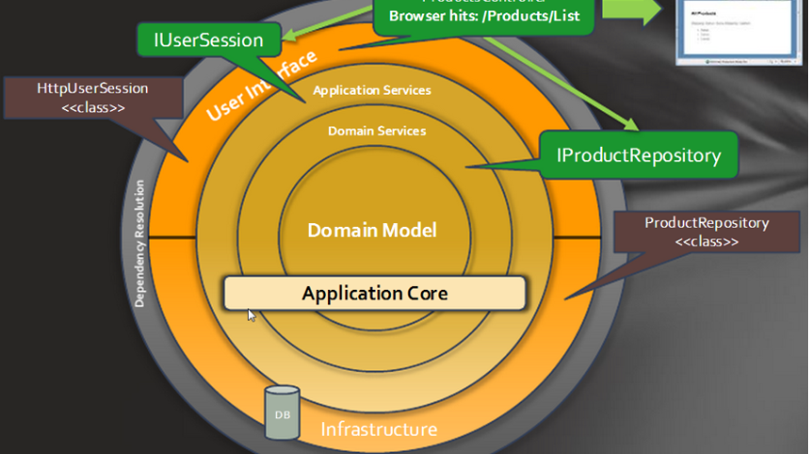

Slide 70
Demo poetry reader

Slide 71
Onion architecture
True loose coupling​
No need for shared utillities projects​
Compiler enforces dependencies boundaries, impossible for core to add reference to infrastructure​
UI and data access become smaller, only technology related stuff in there​
Devs know where to put code (easy model)​
Software is portable not dependent on technology​

Slide 72
Excercises

Slide 73
Conclusion
Think about the structure of you solution, this impacts your deployments and maintenance
Don’t use too many layers
Don’t couple to a delivery mechanism like the web or an implementation detail like a database
Protect your domain, this is the important stuff
Make the UI, database and other infrastructure a plugin to your application

Slide 74
Learning journey
https://www.youtube.com/user/IAmTimCorey/videos (IAmTimCore)
https://www.pluralsight.com/courses/inversion-of-control (PluralSight)
https://docs.microsoft.com/en-us/aspnet/core/fundamentals/dependency-injection
https://channel9.msdn.com/Shows/Visual-Studio-Toolbox/Dependency-Injection (Channel 9)
https://sourcemaking.com/design_patterns/creational_patterns
https://www.youtube.com/watch?v=th4AgBcrEHA (Alistair Cockburn about hexagonal architecture)
https://dzone.com/articles/hexagonal-architecture-is-powerful (Dzone)
https://jeffreypalermo.com/2008/07/the-onion-architecture-part-1/ (Jeffrey Palermo)
https://youtu.be/IAcxetnsiCQ (Ian Cooper about Onion and Ports and adapters in .NET core)

